Slide 1
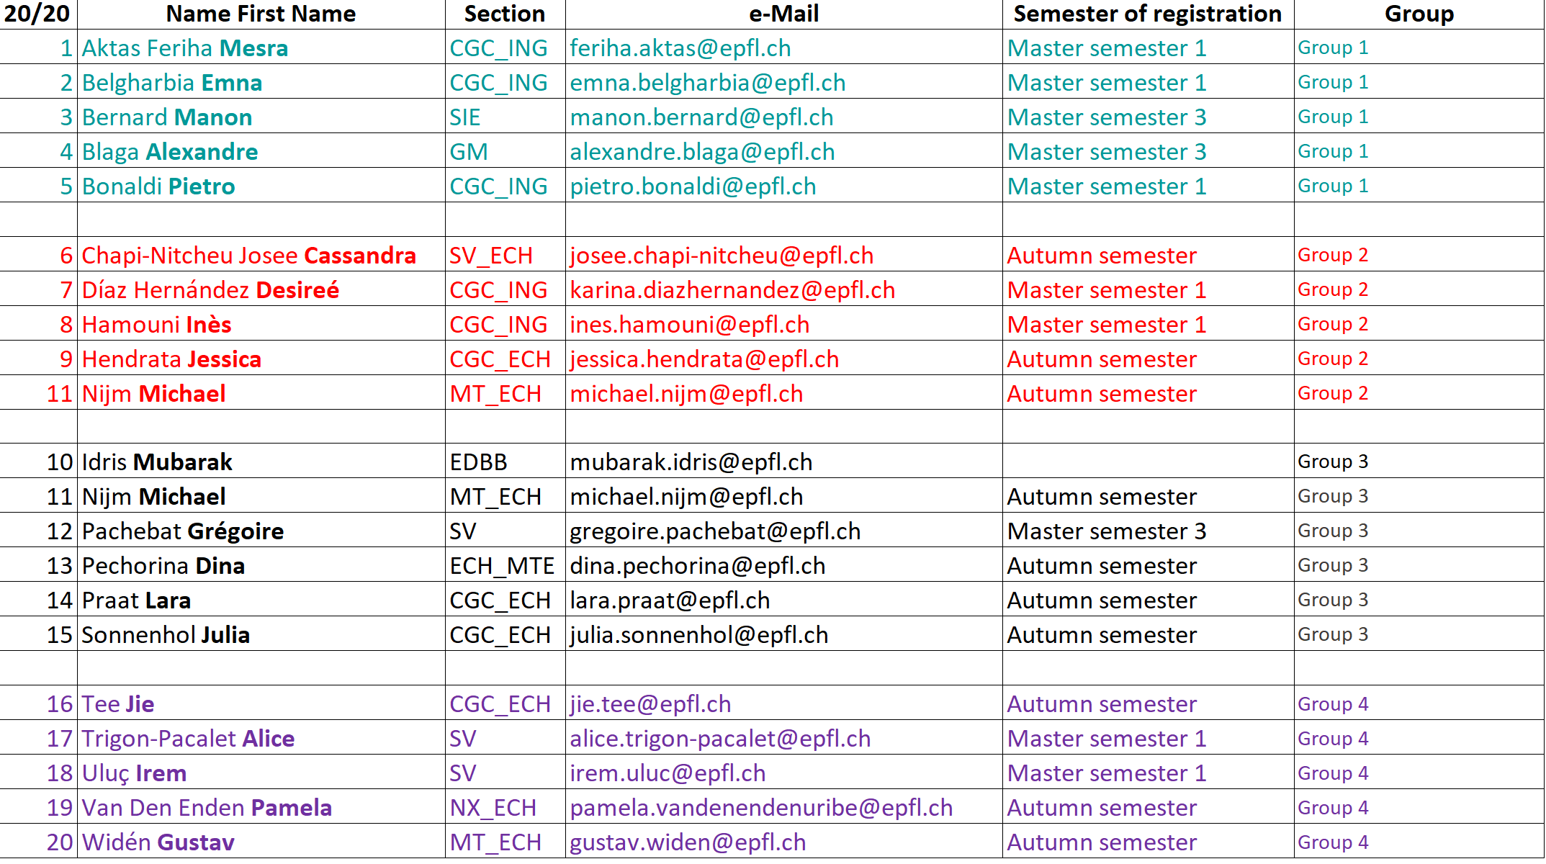
Organisation of the groups for the Q/A session and Assignement

Slide 2

Organisation of the groups for the Q/A session and Assignement
 | 23/09 | 30/09 | 7/10 | 14/10 | 21/10 | 28/10 | 4/11 | 11/11 | 18/11 | 25/11
 | Sanna Fowler | Sébastien Nusslé | Eduardo Moraud | Juliane Da Garca | FALL BREAK | Elpida Tsika | Gregory Servotte | Madiha Derouazi | Carole Estoppey | Bernard Schneider
 | Lonza | genknowme | Unil/CHUV | EPFL |  | AcImmune | Edwards Life siences | Acimmune | Nestlé | PTBTG
 | Pharma | Start-up | Academia | Academia |  | BioTech | Pharma | Pharma | Industry | Academia
 | https://www.lonza.com | https://genknowme.com | http://emmoraud.net/ | https://www.epfl.ch/labs/dangelo-lab/ |  | https://www.acimmune.com/ | https://www.edwards.com/fr | https://www.acimmune.com | https://www.nestle.com/ | https://www.epfl.ch/research/facilities/gene-therapy
Groups for the Q/A session | Group 1 | Group 2 | Group 3 | Group 4 |  | Group 1 | Group 2 | Group 3 | Group 4 | Volunteers (bonus)
Lecture assignement | Group 3 | Group 4 | Group 1 | Group 2 |  | Group 3 | Group 4 | Group 1 | Group 2 | No assignment Time will be allocated to the semester project

Slide 3
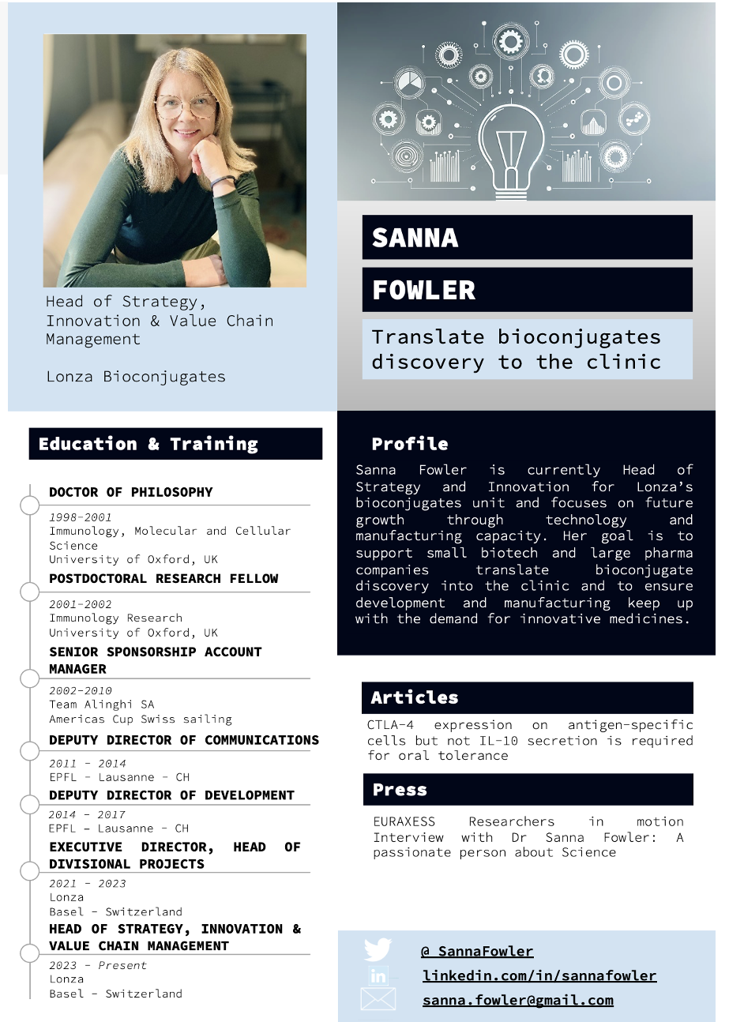
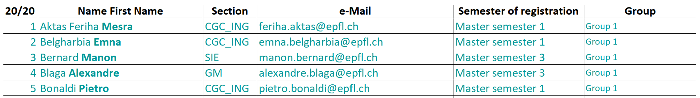
Dr. Sanna Fowler, Lonza Next week
Q/A session
BioENG-430 – How to read a scientific paper efficiently?

